Slide 1

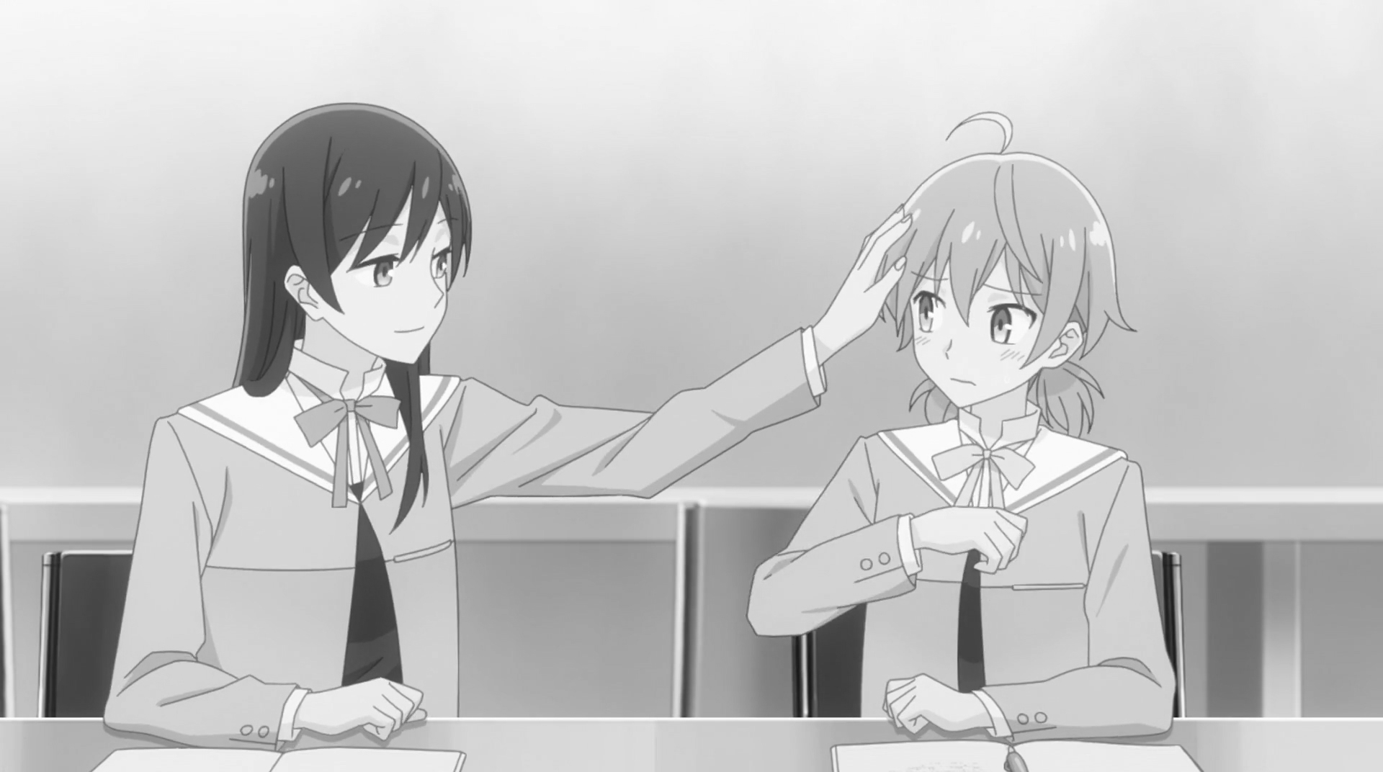
SPMS23019 – Incorporating Gale-Berlekamp Switch Game in Image Steganography
Presented by Le Yanzhi
Supervised by Asst Prof Kiah Han Mao
Introduction
Image Steganography
Gale-Berlekamp Switch Game
The process of hiding information (usually a string) within images.
The least significant bit (LSB) in each pixel value is altered such that it matches the parity of bits in the string.
LSB Replacement: Replace LSB with corresponding parity of the string.
LSB Matching: Randomly add or subtract 1 from pixel value if parity does not match.
Given a matrix of ‘0’s and ‘1’s, each row and column are controlled by a switch.
Turning on the switch (‘0’ → ‘1’) toggles the parity of the bits across the corresponding row or column.
Goal is to fine the combination of toggled switches that minimize the number of ‘1’s within the matrix (excluding switches).
Example: Embed bit value 1 into pixel (0x94)
1 | 0 | 0 | 1 | 0 | 1 | 0 | 0
0 | 0 | 0
1 | 0 | 0
LSB Replacement
Case add 1:
LSB Matching
0
0
0
1 | 0 | 0
0 | 1 | 1
1 | 1 | 0
0
1
0
0 | 0 | 0
0 | 0 | 0
0 | 1 | 0
1 | 0 | 0 | 1 | 0 | 1 | 0 | 1
1 | 0 | 0 | 1 | 0 | 1 | 0 | 1
Optimization
Case subtract 1:
Number of ‘1’s reduced from 5 to 1
1 | 0 | 0 | 1 | 0 | 0 | 1 | 1
Methodology
Cover Image
With Optimization
Without Optimization
Matrix containing information to be embedded is XORed with LSB Matrix to identify mismatch in the form of ‘1’.
Gale-Berlekamp Swich Game is applied to minimize:
number of ‘1’s within the matrix bordered in red, and
number of changes to parity of switches.
The remaining ‘1’s within the matrix bordered in red as well as changes to the parity of the switches are the bit changes to the cover image.
Information can be extracted from the resulting images by turning off all the switches (‘1’ → ‘0’).
1 | 0 | 0 | 1
1 | 0 | 1 | 0
1 | 1 | 1 | 0
0 | 0 | 1 | 0
LSB Matrix (partial)
1 | 0 | 0 | 1
1 | 1 | 0 | 0
1 | 1 | 1 | 1
0 | 1 | 1 | 0
Number of bit changes = 4
Information to be embedded
‘Y’ – ASCII 0101 1001
1 | 0 | 0 | 1
1 | 1 | 0 | 0
1 | 1 | 1 | 1
0 | 1 | 1 | 0
Treated as column switches
1 | 0 | 0 | 1
1 | 1 | 1 | 0
1 | 0 | 0 | 1
0 | 1 | 0 | 0
1 | 0 | 0 | 1
1 | 0 | 0 | 0
0 | 0 | 0 | 0
0 | 1 | 0 | 1
1 | 0 | 0 | 1
1 | 1 | 0 | 0
0 | 1 | 1 | 1
0 | 0 | 1 | 1
0 | 1 | 0
1 | 1 | 0
0 | 1
(1) XOR
(2) Optimization
(3) Embedding
Treated as row switches
Number of bit changes = 3
All switches are initially turned off, regardless of whether its initial value is ‘0’ or ‘1’
‘1’ signifies mismatch in parity of bit between cover image and information
Final state of switch is independent of its initial value
‘0’ – turned off
‘1’ – turned on
Findings
Conclusion
Random bit sequences of various length are generated and tested on greyscale images.
On average, optimization reduces the number of bit changes by 26%.
However, as length increases, time taken to solve the linear optimization problem increased exponentially.
Incorporating Gale-Berlekamp Switch Game leads to lesser bit changes to images during Image Steganography.
Resulting images are less detectable by steganalysis tools and thus more secure.
However, the high time complexity of solving linear optimization problems suggest that this methodology may not be well-suited for very large data sets.
Length of information (bits) | Without Optimization | With Optimization | Time Taken (s)
81 (9 × 9 matrix) | 39 | 27 | 0.313
409 (≈ 20 × 20 matrix) | 206 | 153 | 57.5
819 (≈ 28 × 28 matrix) | 404 | 308 | 5292
_{URECA}
Undergraduate Research Programme
www.ntu.edu.sg

